Slide 1
Exhibits for SoA
Internal copy

Slide 2

In-depth survey
19,209 households
16 states and 1 union territory
45 to 60 minutes
Human centred design research
103 respondents
Multiple locations across 4 states
120 to 160 minutes
Legend
Pulse survey
147,868 households
28 states and union territories
10 to 15 minutes
States covered by both the pulse and in-depth surveys
States covered by only the pulse survey
States not covered by either survey
States included in the human centred design research

Slide 3
102 million
27 million
49 million
20 million
All individuals without Aadhaar
Children,
0 to 5 years
Children,
6 to 17 years
Adults in Assam and Meghalaya
7 million
Adults in other states and union territories
Source: State of Aadhaar pulse survey, 2019 (N = 575,127)
Note: Respondents and household members present during the interview were asked to respond on behalf of themselves and all absent household members. Numbers in the text and the chart may not match due to rounding.

Slide 4
Do not want to enrol into Aadhaar
Tried but failed to enrol
Want to enrol into Aadhaar
Respondents spent an average of Rs. 70 for the entire process
9% used the Aadhaar helpline or registered a formal complaint during enrolment
9 million
25 million
Did not try to enrol
Top three reasons for not enrolling
Did not have an enrolment centre nearby
Did not know where to enrol
Did not have the necessary documents
16 million
Do not have Aadhaar
Want to enrol into Aadhaar
Source: State of Aadhaar in-depth survey, 2019 (N = 1,079)
Note: Numbers in the text and the chart may not match due to rounding.

Slide 5
Legend
Aadhaar-related reasons
0.2% received the service earlier
Non-Aadhaar related reasons
0.6% received the service earlier
MGNREGS
PDS
Social pensions
Bank account
SIM
Source: State of Aadhaar in-depth survey, 2019 (N = 17,332)
Note: Aadhaar-related reasons include failure of biometric authentication, inability to link card/ service with Aadhaar, and not having Aadhaar. Non-Aadhaar related reasons include lack of knowledge to access the service, limited availability of the service, and mis-directed payments, among others. Numbers in the text and the chart may not match due to rounding.

Slide 6
Legend
2%
1%
Very satisfied
Somewhat satisfied
Neither satisfied nor unsatisfied
Somewhat unsatisfied
Very unsatisfied
Source: State of Aadhaar pulse survey, 2019 (N = 147,868)
Note: Numbers in the text and the chart may not match due to rounding.

Slide 7
ARCHIVE

Slide 8
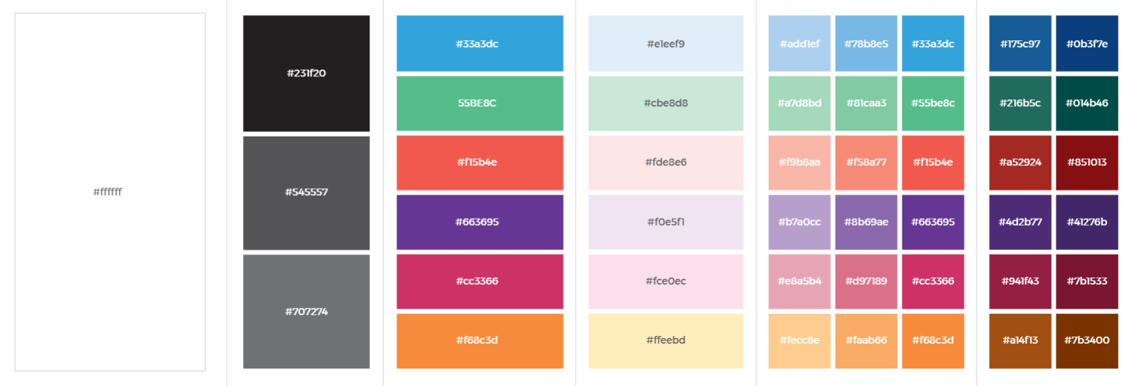
SoA colour pallete

